Slide 1

Progress PPT(220415) [Automatic Story Generation]
Notes:
Hello professors. This is Yoonseok a team leader of the team 3. I am making a presentation for our group project progress
Our previous topic was to address a visual commonsense reasoning.
However, we had some issues so we decided to change our topic to such an interesting one, called automatic story generation task.

Slide 2
Problem: Lack of Consensus on our task
Currently no consensus on the problem we are trying to tackle
So far, we have four things to be considered:
Case 1: Korean Story Generator
Case 2: GPT2 trained on the “Children-book-and-stories” dataset
CASE 3: STORIUM
Case 4: Plot Machines
➔ All methods fall into the broad category of story generation, but not all methods address the same problem.
Notes:
연속성을 고려한 스토리 생성 연구는 아직 없다.

Slide 3
Case 1/2: Language Model based Story Generation
Given a part of a story, the system continuously creates the next
Language modeling-based approach using auto-regressive characteristic of GPT2
Input: a few sentences from the beginning of the story
Output: the next story
in
the
forest
of
GPT-2
A set of token_ids
GPT-2 Tokenizer
Word-level Inputs
Every year the evil Protectorate offers a baby to the evil witch
in
the
forest
of
Notes:
연속성을 고려한 스토리 생성 연구는 아직 없다.

Slide 4
Case 1/2: Language Model based Story Generation
Pros: training using the story text itself(w/o human-labeling)
Easy to obtain large scale children-stories
Input: a few sentences from the beginning of the story
Cons: No need to human guidance
This method does not have any mechanism to put any knowledge (guidance) of humans
Notes:
연속성을 고려한 스토리 생성 연구는 아직 없다.

Slide 5
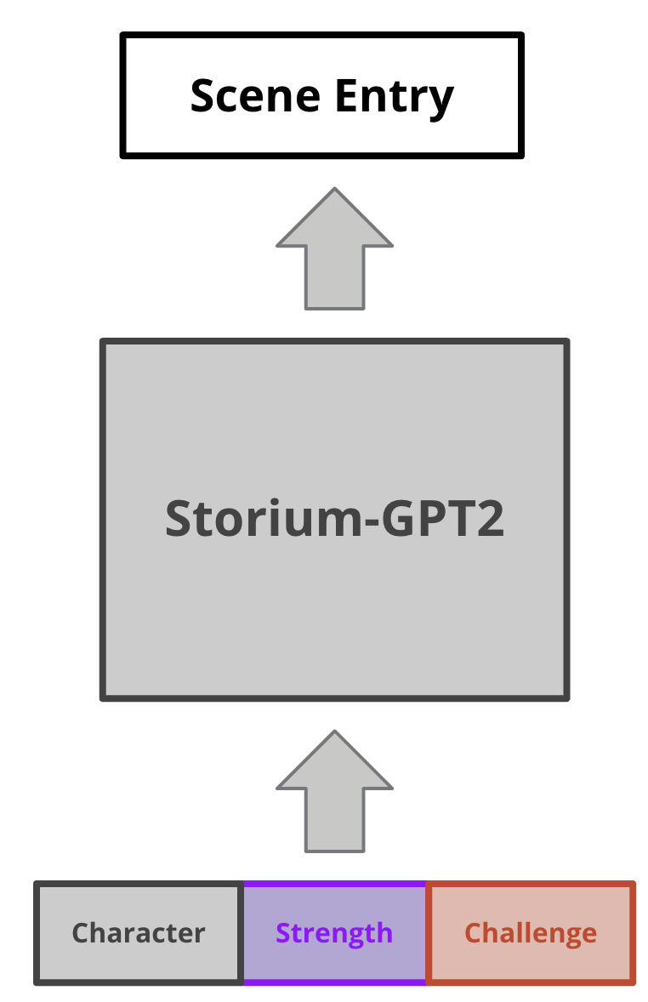
Case 3: Fine-grained annotations-based Story Generation(STORIUM)
STORIUM: a large-scale story generation corpus that include fine-grained human annotations of scenes
The data set is a set of pairs, each of which is human-labeled metadata in the form of sentences and its actual story
character description, event description, etc…
Problem Setup
Given a set of meta data, a system should generate an optimal story that can reflect the meta data
Meta Data
(Story guideline)
Notes:
연속성을 고려한 스토리 생성 연구는 아직 없다.

Slide 6
Case 3: Fine-grained annotations-based Story Generation(STORIUM)
Pros: It is possible to create a consistent story because there are specific guidelines for the next scene.
High-quality data sets designed by the authors
Cons -1: High Complexity
The number of characters and the story flow are very diverse
Con2 -2: Too much restriction on human-labeled guidance
Too dependent on the dataset itself(➔ Low Scalability)
Notes:
연속성을 고려한 스토리 생성 연구는 아직 없다.

Slide 7
Case 4: Plot-Machines
Outline-conditioned Story Generation
Input: Descriptions(a few sentences) of the overall story
Output: a story(a set of sentences)
Example: Writing Prompts Story
Dataset: Writing Prompts
Notes:
연속성을 고려한 스토리 생성 연구는 아직 없다.

Slide 8
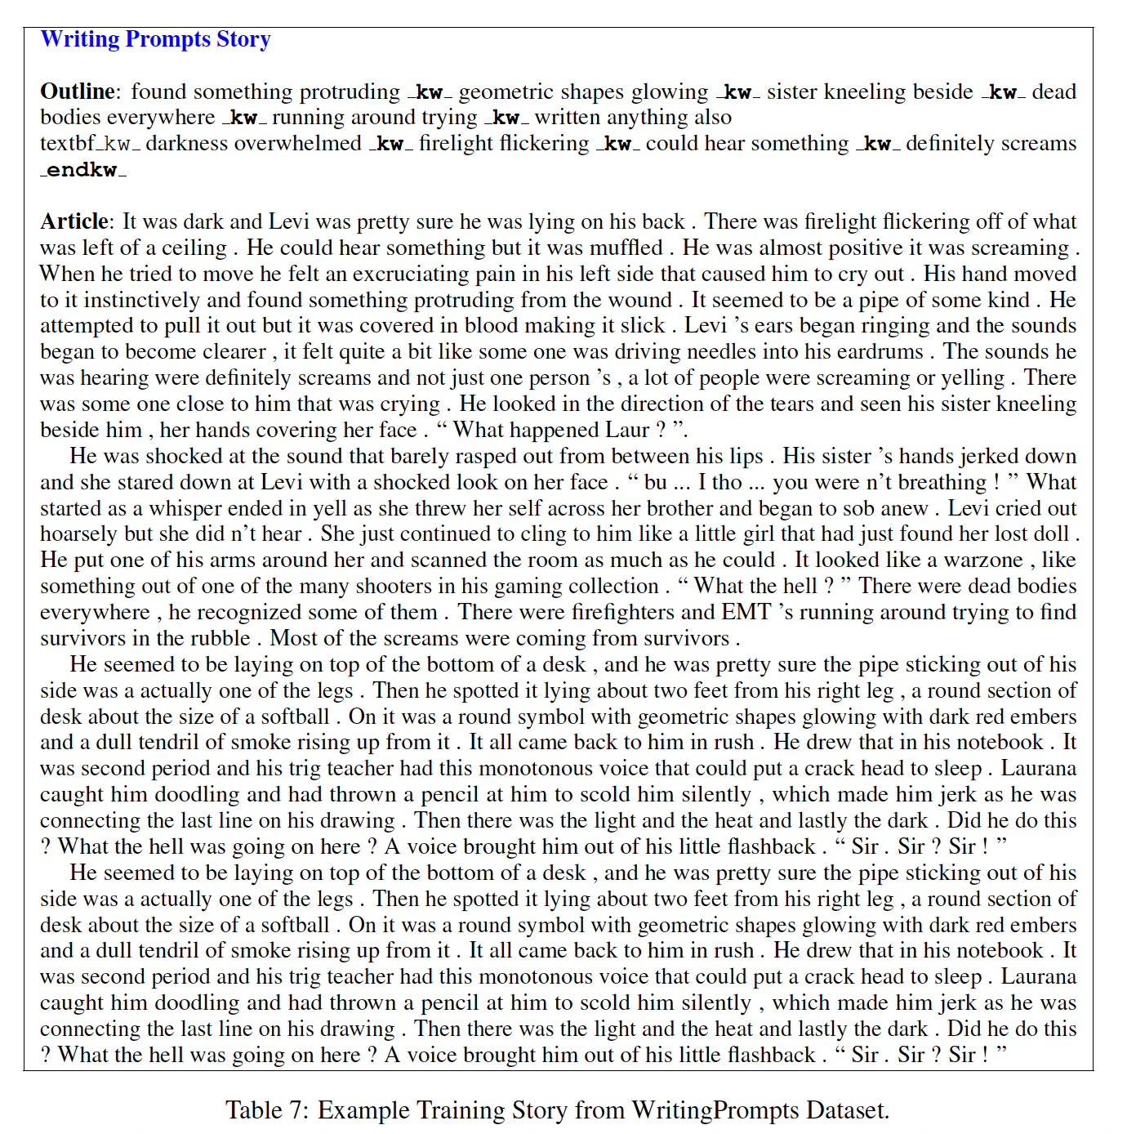
Case 4: Plot-Machines
Notes:
연속성을 고려한 스토리 생성 연구는 아직 없다.

Slide 9
Case 4: Plot-Machines
Notes:
연속성을 고려한 스토리 생성 연구는 아직 없다.

Slide 10
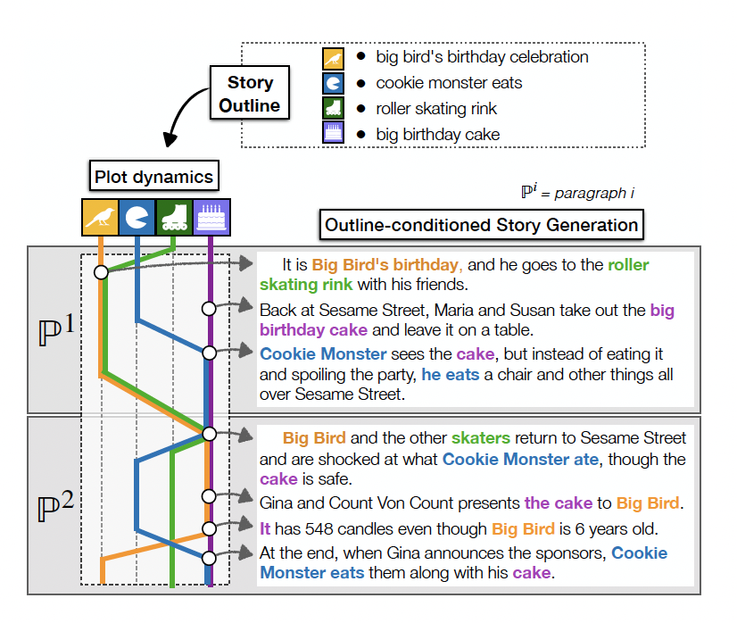
Case 4: Plot-Machines
Memory based Dynamic Plot state tracking
Reasonable amounts of human intervention
Notes:
연속성을 고려한 스토리 생성 연구는 아직 없다.

Slide 11
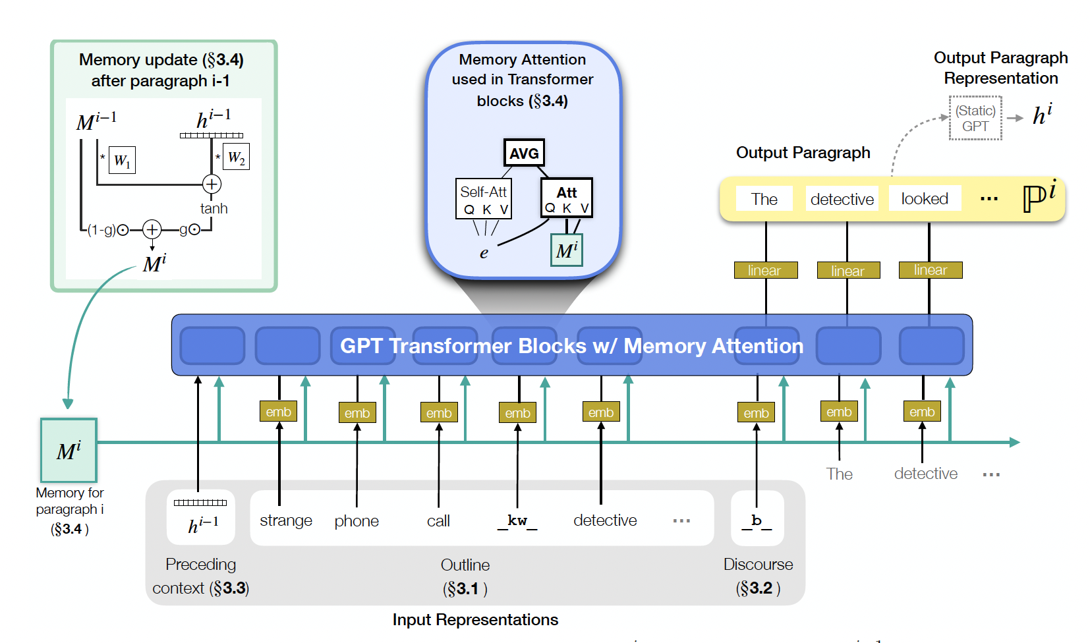
Case 4: Plot-Machines
Maintaining the previous stories by memory cell(like LSTM Cell State)
Notes:
연속성을 고려한 스토리 생성 연구는 아직 없다.

Slide 12
Summary
Case 1 / 2: Language Models for story generation task ➔ Korean story generator / David Model
Case 3: Complex Story Generation Task ➔ Storium
Case 4: Outline-conditioned story generation ➔ Plot-machine
So, what type of task are we going to address? We need to focus one task and dive into source code analysis
Notes:
연속성을 고려한 스토리 생성 연구는 아직 없다.

Slide 13
Possible Approaches
We do not have any children story dataset with OUTLINEs
Step 1: Fine-tune transformer-based language models on Writing-Prompts
Writing-Prompts: A set of pairs of outlines(first few sentences) and its corresponding story (NOT CHILDREN STORY DOMAIN)
LM options
GPT-2 based models
Encoder-Decoder Frameworks: BART, T5
Notes:
연속성을 고려한 스토리 생성 연구는 아직 없다.

Slide 14
Possible Approaches
Step 2: Make outlines by ourselves to testify our model on Children stories
Candidate Datasets
Fairy-tale QA datasets from Project Gutenberg
highly-rated-children-books-and-stories datasets
Find children stories from Storium
We can generate outlines by ourselves or use summarizers, and use them as inputs, which are outlines of children books
Notes:
연속성을 고려한 스토리 생성 연구는 아직 없다.

Slide 15
Possible Approaches
Step 3: Post Training Strategy(Han et al., 2021 NAACL)
In order to fuse knowledge(words, contexts) on children stories into language models, we can additionally train them on many unlabeled children stories before the REAL fine-tuning step
training on children-stories (fine-tuning)
Pretrained
GPT2(BART)
Children Story Generation Models
Notes:
연속성을 고려한 스토리 생성 연구는 아직 없다.

Slide 16
Possible Approaches
Step 3: Post Training Strategy(Han et al., 2021 NAACL)
In order to fuse knowledge(words, contexts) on children stories into language models, we can additionally train them on many unlabeled story datasets before the REAL fine-tuning step
We can obtain the models that are familiar with the nuance or style of sentences on novels
training on stories (Post-training)
training on children-stories (fine-tuning)
Pretrained
GPT2(BART)
Intermediate
Models
Children Story Generation Models
Next Token Prediction
Entity Prediction Task
Generic
Knowledge
More specialized in stories
Notes:
연속성을 고려한 스토리 생성 연구는 아직 없다.

